Slide 1
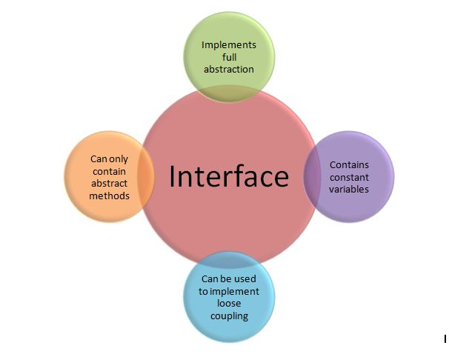
Java- Interface

Slide 2
What is an Interface in Java?
abstract class which is used for achieving partial abstraction. Unlike abstract class an interface is used for full abstraction.
Abstraction is a process where you show only “relevant” data and “hide” unnecessary details of an object from the user
What is an interface in java, why we use it and what are rules that we must follow while using interfaces in Java Programming.

Slide 3
What is an Interface?
What is an interface in Java?
Interface looks like a class but it is not a class.
It is similar to class. It is a collection of abstract methods.
A class implements an interface, thereby inheriting the abstract
methods of the interface.
An interface is a reference type in Java.
Along with abstract methods, an interface may also contain
constants, default methods, static methods, and nested types.
Method bodies exist only for default methods and static methods.
Writing an interface is similar to writing a class. But a class
describes the attributes and behaviors of an object. And an interface
contains behaviors that a class implements.
Unless the class that implements the interface is abstract, all the
methods of the interface need to be defined in the class
An interface can have methods and variables just like the class but
the methods declared in interface are by default abstract (only
method signature, no body, see: Java abstract method).
Also, the variables declared in an interface are public, static & final
by default.

Slide 4
Java- Interface?
Interface are used for full abstraction. Since methods in interfaces do not have body, they have to be implemented by the class before you can access them.
The class that implements interface must implement all the methods of that interface.
Also, java programming language does not allow you to extend more than one class, However you can implement more than one interfaces in your class.
Syntax:
Interfaces are declared by specifying a keyword “interface”. E.g.:
interface MyInterface {
/* All the methods are public abstract by default
* As you see they have no body
*/
public void method1();
public void method2();
}

Slide 5
How Class & Interfaces?
An interface is similar to a class in the following ways −
An interface can contain any number of methods.
An interface is written in a file with a .java extension, with the name
of the interface matching the name of the file.
The byte code of an interface appears in a .class file.
Interfaces appear in packages, and their corresponding bytecode
file must be in a directory structure that matches the package name.
However, an interface is different from a class in several ways, including −
You cannot instantiate an interface.
An interface does not contain any constructors.
All of the methods in an interface are abstract.
An interface cannot contain instance fields. The only fields that can
appear in an interface must be declared both static and final.
An interface is not extended by a class; it is implemented by a
class.
An interface can extend multiple interfaces.

Slide 6
Declaring Interfaces
The interface keyword is used to declare an interface. Here is a simple example to declare an interface −
Following is an example of an interface −
/* File name : NameOfInterface.java */
import java.lang.*;
// Any number of import statements
public interface NameOfInterface {
// Any number of final, static fields
// Any number of abstract method declarations\
}
Interfaces have the following properties −
An interface is implicitly abstract. You do not need to use the abstract keyword while declaring an interface.
Each method in an interface is also implicitly abstract, so the abstract keyword is not needed.
Methods in an interface are implicitly public.
Example
/* File name : Animal.java */
interface Animal {
public void eat();
public void travel();
}

Slide 7
Example of an Interface in Java
How a class implements an interface?
It has to provide the body of all the methods that are declared in interface or in other words you can say that class has to implement all the methods of interface.
Do you know? class implements interface but an interface extends another interface.

Slide 8
interface MyInterface {
/* compiler will treat them as:
* public abstract void method1();
* public abstract void method2();
*/
public void method1();
public void method2();
}
class Demo implements MyInterface {
/* This class must have to implement both the abstract methods
* else you will get compilation error
*/
public void method1() {
System.out.println("implementation of method1");
}
public void method2() {
System.out.println("implementation of method2");
}
public static void main(String arg[]) {
MyInterface obj = new Demo();
obj.method1();
}
}

Slide 9
Interface and Inheritance
An interface can not implement another interface. It has to extend the other interface.
Here two interfaces Inf1 and Inf2. Inf2 extends Inf1 so If class implements the Inf2 it has to provide implementation of all the methods of interfaces Inf2 as well as Inf1.
interface Inf1{
public void method1();
}
interface Inf2 extends Inf1 {
public void method2();
}
public class Demo implements Inf2{
/* Even though this class is only implementing the
* interface Inf2, it has to implement all the methods
* of Inf1 as well because the interface Inf2 extends Inf1
*/
public void method1(){
System.out.println("method1");
}
public void method2(){
System.out.println("method2");
}
public static void main(String args[]){
Inf2 obj = new Demo();
obj.method2();
}
}

Slide 10
In this program, the class Demo only implements interface Inf2, however it has to provide the implementation of all the methods of interface Inf1 as well, because interface Inf2 extends Inf1.
Tag or Marker interface in Java
An empty interface is known as tag or marker interface. For example Serializable, EventListener, Remote(java.rmi.Remote) are tag interfaces. These interfaces do not have any field and methods in it.
Nested interfaces
An interface which is declared inside another interface or class is called nested interface. They are also known as inner interface.
For example Entry interface in collections framework is declared inside Map interface, that’s why we don’ use it directly, rather we use it like this: Map.Entry.

Slide 11
Key points about interfaces:
We can’t instantiate an interface in java. That means we cannot create
the object of an interface
Interface provides full abstraction as none of its methods have body.
On the other hand abstract class provides partial abstraction as it can
have abstract and concrete(methods with body) methods both.
implements keyword is used by classes to implement an interface.
While providing implementation in class of any method of an
interface, it needs to be mentioned as public.
Class that implements any interface must implement all the methods
of that interface, else the class should be declared abstract.
Interface cannot be declared as private, protected or transient.
All the interface methods are by default abstract and public.
Variables declared in interface are public, static and final by default.

Slide 12
interface Try {
int a=10;
public int a=10;
public static final int a=10;
final int a=10;
static int a=0;
}
All of the above statements are identical.
Interface variables must be initialized at the time of declaration otherwise compiler will throw an error.
interface Try {
int x;//Compile-time error
}
Above code will throw a compile time error as the value of the variable x is not initialized at the time of declaration.
Inside any implementation class, you cannot change the variables declared in interface because by default, they are public, static and final.
Here we are implementing the interface “Try” which has a variable x. When we tried to set the value for variable x we got compilation error as the variable x is public static final by default and final variables can not be re-initialized.
class Sample implements Try {
public static void main(String args[]) {
x=20; //compile time error
}
}

Slide 13
An interface can extend any interface but cannot implement it. Class implements interface and interface extends interface.
A class can implement any number of interfaces.
If there are two or more same methods in two interfaces and a class implements both interfaces, implementation of the method once is enough.
interface A {
public void aaa();
}
interface B {
public void aaa();
}
class Central implements A,B {
public void aaa() {
//Any Code here
}
public static void main(String args[]) {
//Statements
}
}

Slide 14
A class cannot implement two interfaces that have methods with same name but different return type.
interface A {
public void aaa();
}
interface B {
public int aaa();
}
class Central implements A,B {
public void aaa() // error {
}
public int aaa() // error {
}
public static void main(String args[]) {
}
}

Slide 15
Variable names conflicts can be resolved by interface name.
interface A {
int x=10;
}
interface B {
int x=100;
}
class Hello implements A,B {
public static void Main(String args[])
{
/* reference to x is ambiguous both variables are x
* so we are using interface name to resolve the
* variable
*/
System.out.println(x);
System.out.println(A.x);
System.out.println(B.x);
}
}

Slide 16
Advantages of interface in java:
Without bothering about the implementation part, we can achieve the security of implementation.
In java, multiple inheritance is not allowed, however you can use interface to make use of it as you can implement more than one interface.

Slide 17
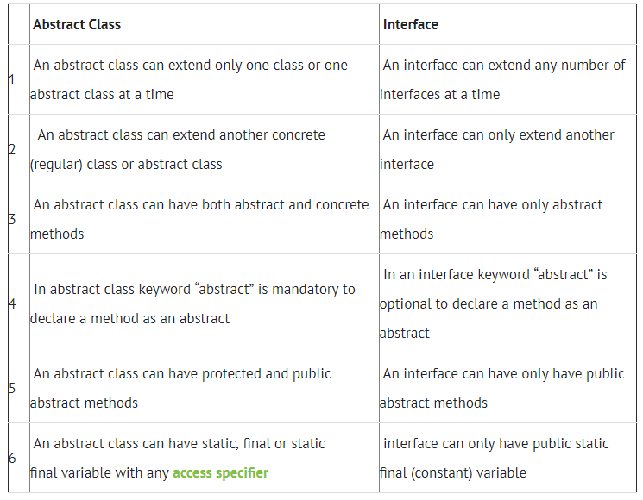
Difference Between abstract class & interface

Slide 18
Java Interface in Real Life
Java_Interfaces_In_Real_Life.txt
ModemTesting.java

